Slide 1
Historical Influences
CS 245
CS 245 – Robotics and Machine Learning
Notes:
Start 9/10

Slide 2
Charles Babbage
Father of Computing (?)
Born December 26, 1791 in Teignmouth, Devonshire UK
Died 1871, London
Inventions:
  Analytical Engine and Difference Engine
  Dynamometer
  Standard railroad gauge
  Greenwich time signals
  Heliograph opthalmoscope
CS 245 – Robotics and Machine Learning

Slide 3
Charles Babbage
Babbage’s work influenced:
  Jacquard punch cards
  Chains and subassemblies
  The logical structure of the modern computer
Not recognized during his lifetime (or afterwards)
  Only one carriage followed in the burial procession
  The Royal Society printed no obituary
  The Times ridiculed him
  The parts of the Difference Engine that had seemed possible of completion in 1830 gathered dust in the Museum of King's College.
  In 1878 The Cayley committee told the government not to bother constructing Babbage's Analytical Engine
  By the 1880's Babbage was known primarily for his reform of mathematics at Cambridge
  In 1899 the magazine Temple Bar reported that "the present generation appears to have forgotten Babbage and his calculating machine“
  In 1908, after being preserved for 37 years in alcohol, Babbage's brain was dissected by Sir Victor Horsley of the Royal Society.
    Horsley had to remind the society that Babbage had been a "very profound thinker".
CS 245 – Robotics and Machine Learning

Slide 4
Charles Babbage
Considered becoming a cleric
In 1837 he published his Ninth Bridgewater Treatise, to reconcile his scientific beliefs with Christian dogma.
  Babbage argued that miracles were not, as Hume write, violations of laws of nature, but could exist in a mechanistic world.
  As Babbage could program long series on his calculating machines, God could program similar irregularities in nature.
Babbage investigated biblical miracles
  "In the course of his analysis", wrote B. V. Bowden in Faster than Thought (Pitman, London, 1971), "he made the assumption that the chance of a man rising from the dead is one in 10¹²".
  Miracles are not, as he wrote in Passages From the Life of a Philosopher, "the breach of established laws, but... indicate the existence of far higher laws".
CS 245 – Robotics and Machine Learning

Slide 5
Charles Babbage
In July of 1822
  Babbage wrote a letter to the president of the Royal Society, describing his plan for calculating and printing mathematical tables by machine
By June of 1823
  Babbage met with the Chancellor of the Exchequer, who granted money and told Babbage to proceed with the engine (which he did, starting work in July).
In August 1827
  Babbage's 35-year-old wife, Georgiana, died. Babbage traveled to the Continent.
  By the end of 1828 he returned to England, the initial £1,500 grant gone.
  Babbage was financing the construction himself
In 1829
  A group of Babbage's friends solicited the attention of the Duke of Wellington, then Prime Minister. Wellington went to see a model of the engine, and in December ordered a grant of £3,000.
  Engineer Joseph Clement was hired to construct the engine for the government, and to oversee the fabrication of special tools.
CS 245 – Robotics and Machine Learning

Slide 6
Charles Babbage
In 1830
  Babbage wanted to move the engine's workshop to his house on Dorset Street.
  Clement refused to move from his own workshop, and made, according to Babbage, "inordinately extravagant demands".
  Babbage would not advance Clement further money, so Clement dismissed his crew, and work on the Difference Engine ceased.
  Babbage’s initial scheme for the Difference Engine called for six decimal places and a second-order difference
  Now he began planning for 20 decimal places and a sixth-order difference (Analytical Engine)
  "His ambitious to build immediately the largest Difference Engine that could ever be needed", wrote Bowden, "probably delayed the exploitation of his own ideas for a century".
In 1834
  Babbage searched for funds for the new engine (half-price of the original)
  But the government did not wish to fund a new engine until the old one was complete.
  "He was ill-judged enough", wrote the Reverend Richard Sheepshanks, a secretary of the Royal Astronomical Society, "to press the consideration of this new machine upon the members of Government, who were already sick of the old one".
  Sheepshanks was Babbage's archenemy. In 1854 he published a vituperative 100-page work, "Letter to the Board of Visitors of the Greenwich Royal Observatory, in Reply to the Calumnies of Mr.Babbage" at its meeting in June 1853, and in his book entitled The Exposition of 1851
CS 245 – Robotics and Machine Learning

Slide 7
Charles Babbage
In 1842
  The Chancellor of the Exchequer, having been told it was "worthless", said he and Peel regretted the necessity of abandoning the project. On the 11th of November, Babbage finally met with Peel, and was told the bad news.
By 1851
  Babbage had "given up all expectation of constructing the Analytic Engine“
  Though he was to try once more with Disraeli the next year
  He wrote in the vitriolic Exposition of 1851: "Thus bad names are coined by worse men to destroy honest people, as the madness of innocent dogs arises from the cry of insanity raised by their villainous pursuers".
  Some believed Babbage had "been rewarded for his time and labor by grants from the public use", according to biographer Moseley Maboth (Irascible Genius, Hutchinson & Co., London, 1964). "We got nothing for our £17,000 but Mr. Babbage's grumblings", wrote Sheepshanks in his "Letter to the Board of Visitors of the Greenwich Royal Observatory". "We should at least have had a clever toy for our money".
Offered a baronetcy in recognition of his work, Babbage refused, demanding a life peerage instead. It was never granted.
CS 245 – Robotics and Machine Learning

Slide 8
Charles Babbage
"Those whose minds are entirely unoccupied", he wrote with some seriousness in Observations of Street Nuisances in 1864, "receive [street music] with satisfaction, as filling up the vacuum of time". He calculated that 25% of his working power had been destroyed by street nuisances, many of them intentional.
  Letters to the Times and the eventual enforcement of "Babbage's Act", which would squelch street nuisances, made him the target of ridicule.
  Some neighbors hired musicians to play outside his windows. Others willfully annoyed him with worn-out or damaged wind instruments.
When Babbage went out, children followed and cursed him.
  Adults followed, too, but at a distance.
  Over a hundred people once skulked behind him before he could find a constable to disperse them.
  Dead cats and other "offensive materials" were thrown at his house.
  Windows were broken.
  A man told him, "You deserve to have your house burnt up, and yourself in it, and I will do it for you, you old villain". Even when he was on his deathbed, the organ-grinders ground implacably away.
CS 245 – Robotics and Machine Learning

Slide 9
Charles Babbage
So why were engines never completed?
  The limitations of Newtonian physics might have prevented Babbage from completing any Analytical Engine.
  Unaware of the advances of Maxwell (and could not know those of Boltzmann, Gödel, and Heisenberg).
  Though he knew Fourier socially, Babbage did not seem to grasp the importance of his 1811 work on heat propagation.
  Nor did he seem to know of Joule's efforts with heat and mechanical energy.
  Babbage was essentially a child of the Enlightenment, and his epoch was much different from our own. He resided in an era of wood and coal, and the later era of steel and oil would not begin for perhaps a decade after his death.
CS 245 – Robotics and Machine Learning

Slide 10
Charles Babbage
“Every moment dies a man/Every moment 1 1/16 is born.”
  (A correction to Tennyson's "Ev'ry moment a man dies/Ev'ry moment one is born".)
CS 245 – Robotics and Machine Learning

Slide 11
Nikola Tesla
The Serbian-American inventor, electrical engineer, and scientist
Born on July 9/10, 1856 in Smiljani, Lika (Austria-Hungary)
Died on January 7, 1943 in New York City, New York
Inventions:
  Electricity as we know it today
  telephone repeater
  rotating magnetic field principle
  polyphase alternating-current system
  induction motor
  alternating-current power transmission
  Tesla coil transformer
  wireless communication
  Radio
  fluorescent lights
  and more than 700 other patents.
CS 245 – Robotics and Machine Learning

Slide 12
Nikola Tesla
Education
  Fluent in eight languages (English, Serbian, Croatian, Czech, Hungarian, French, German, Italian)
  Elementary school: Gospić (Austria-Hungary, now Croatia)
  Secondary school: Karlovac (Austria-Hungary, now Croatia)
  Undergraduate
    Baccalaureate of Physics: Austrian Polytechnic Institute (Graz)
    Baccalaureate of Mathematics: Austrian Polytechnic Institute (Graz)
    Baccalaureate of Mechanical Engineering: Austrian Polytechnic Institute (Graz)
    Baccalaureate of Electrical Engineering: Austrian Polytechnic Institute (Graz)
  Graduate studies
    PhD in Physics: University of Prague (Prague)
Namings honors
  The tesla (symbol T) - compound derived SI unit of magnetic flux density.
  Tesla - a crater on the far side of the moon of 26 kilometers in diameter at -2,0°width, -132.0°height.
  2244 Tesla - a minor planet.
  Nikola Tesla - the largest power plant in Serbia, 2.8GW
  The rock band Tesla takes its name from Nikola Tesla.
  There is a Japanese comic (manga) called Super Person Nikola Tesla.
CS 245 – Robotics and Machine Learning

Slide 13
Nikola Tesla
"Tesla has contributed more to electrical science than any man up to his time." —Lord Kelvin
"[Tesla is] an eminent pioneer in the realm of high frequency currents... I congratulate [him] on the great successes of [his] life's work." —Albert Einstein
"The world, I think, will wait a long time for Nikola Tesla's equal in achievement and imagination." - Edwin H. Armstrong
"... all scientific men will be delighted to extend their warmest congratulations to Tesla and to express their appreciation of his great contributions to science." —Ernest Rutherford
"Tesla is entitled to the enduring gratitude of mankind." —Arthur Compton
"I am sending [Dr. Tesla]... my gratitude and my respect in overflowing measure." —Robert Millikan
"The evolution of electric power from the discovery of Faraday to the initial great installation of the Tesla polyphase system in 1896 is undoubtedly the most tremendous event in all engineering history." —Charles F. Scott
"[Dr. Tesla's] lectures opened a new physical world to me... [He was] one of the kindest men I've ever encountered. The hours which I was permitted to spend together with [him] will always be among the fondest memories of my life." —Jonathan Zenneck
"We think of his contribution much oftener than that of Ampere and Ohm ... the induction motor and our power system are enduring monuments to Nikola Tesla." — Dr. E.F.W. Alexanderson
CS 245 – Robotics and Machine Learning

Slide 14
Nikola Tesla
He was one of five children, having one brother and three sisters (All married priests)
His family moved to Gospić in 1862.
Tesla went to school in Karlovac (Austria-Hungary), then studied electrical engineering at the Austria Politechnic in Graz, Austria (1875).
  While there, he studied the uses of alternating current. Tesla invented a precursor to modern wireless telephone, known as a telephone repeater (or sometimes an amplifier).
In 1881
  Moved to Budapest to work for the telegraph company, American Telephone Company
  Tesla became the chief electrician to the telephone company, later engineer to the Yugoslav government and the country's first telephone system.
CS 245 – Robotics and Machine Learning

Slide 15
Nikola Tesla
For a while he stayed in Maribor (Slovenia).
  He was employed at his first job as an assistant engineer.
  Tesla suffered a nervous breakdown during this time.
In 1882
  Moved to Paris to work as an engineer for the Continental Edison Company. He worked designing improvements to electric equipment.
  In the same year, Tesla conceived of the induction motor and began developing various devices that use rotating magnetic fields (for which he received patents in 1888).
In 1884
  Tesla moved to the United States of America to accept a job with the Edison Company in New York City.
  He arrived in the US with 4 cents to his name, a book of poetry, and a letter of recommendation (from Charles Batchelor, his manager in his previous job).
CS 245 – Robotics and Machine Learning

Slide 16
Nikola Tesla
Tesla worked for Thomas Edison for a time.
  Edison offered him $50,000 for improvements in Edison's DC dynamos.
  Upon returning to Edison and inquiring about the $50,000, Edison replied, "Tesla, you don't understand our American humor." Tesla resigned.
In 1886
  Tesla formed his own company, “Tesla Electric Light & Manufacturing”.
    The initial financial investors disagreed with Tesla on his plan for an alternating current motor and eventually relieved Tesla of his duties at the company. Tesla was unemployed for a time.
From 1886 to 1887
  Tesla worked on the streets of New York as a common laborer to raise capital to eat and for his next project.
In 1887
  he constructed the initial brushless alternate-current induction motor. He demonstrated the brushless two-phase one-fifth horsepower (150 W) induction motor to the American Institute of Electrical Engineers (now IEEE) in 1888.
In 1888
  he developed the principles of his Tesla coil. In the same period, he began working with Westinghouse, Westinghouse's Pittsburgh labs. Westinghouse listened to Tesla's ideas for polyphase systems. These systems would allow alternating current [AC] electricity to be transmitted over large distances.
CS 245 – Robotics and Machine Learning

Slide 17
Nikola Tesla
In 1887
  Tesla began investigating what would later be called X-rays using his own devices as well as Crookes tubes. He did this by experimenting with high voltages and vacuum tubes.
  His technical publications indicate that he invented and developed a special single-electrode X-ray tube. Tesla's tubes differed from other X-ray tubes in that they had no target electrode.
  The modern term for this is the ‘bremsstrahlung’ process, in which a high-energy secondary X-ray emission is produced when charged particles (such as electrons) pass through matter.
In 1891
  Tesla became a naturalized American citizen.
  Also in this year, Tesla established his Houston Street laboratory in New York.
    He lit vacuum tubes wirelessly in the lab, providing evidence for the potential of wireless power transmission.
  Around this time, Tesla developed a close and lasting friendship with author and humorist Mark Twain. They spent quite a bit of time together in Tesla's lab and other areas. Tesla's closest friends were writers and artists.
By 1892
  Tesla became aware of certain characteristics later identified by Wilhelm Conrad Röntgen as effects of X-rays.
  He performed several experiments (including taking photographs of the bones of his hand) but did not make his findings widely known. Much of his research was lost in the 1895 Houston Street lab fire. He did obtain pictures of the human body with X-rays and subsequently sent the images to Röntgen. His later X-ray experimentation by vacuum high field emissions led him to alert the scientific community first to the biological hazards associated with X-ray exposure.
CS 245 – Robotics and Machine Learning

Slide 18
Nikola Tesla
From 1892 to 1894
  Tesla served as the Vice-President of AIEE, the American Institute of Electrical Engineers (now part of the IEEE).
From 1893 to 1895
  Tesla investigated high frequency alternating currents.
  He generated one million volts of alternating currents using a conical Tesla coil. He developed the skin effect in circuitry, designed tuned circuits, invented a machine for inducing sleep, cordless gas discharge lamps, and transmitted electromagnetic energy without wires, effectively building the first radio transmitter.
In 1893
  In St. Louis, Missouri, Tesla made the first public demonstration of radio communication.
  He described and demonstrated in detail the principles of radio communication.
  The apparatus he used contained all the elements that were incorporated into radio systems before the development of the vacuum tube.
In 1893
  Tesla and Westinghouse introduced visitors of the Chicago World Fair to AC power by providing AC energy to illuminate the World Columbian Exposition
  Tesla displayed the first neon light tubes at the exposition, demonstrating his phosphorescent lighting powered without wires by high-frequency fields.
CS 245 – Robotics and Machine Learning

Slide 19
Nikola Tesla
AC/DC
  Tesla won the “War of Currents”
  Against General Electric and Edison's proposal, Tesla's AC system won the international Niagara Falls Commission contract.
    The commission was led by Lord Kelvin and backed by entrepreneurs (such as J.P. Morgan, Lord Rothschild, and John Jacob Astor).
  Work began in 1893 on the Niagara Falls generation project and Tesla's technology was applied to generate electromagnetic energy from the falls.
On November 16, 1896
  the first transmission of electrical power between two cities was sent from Niagara Falls to industries in Buffalo from the first commercial two-phase power plants (known as hydroelectric generators) at the Edward Dean Adams Station.
  Tesla also set the 60 hertz standard for North America…
CS 245 – Robotics and Machine Learning

Slide 20
Nikola Tesla
In 1899
  Tesla decided to move and began conducting research in Colorado (near Colorado Springs), where he could have room for his high-voltage high-frequency experiments.
  He experimented with high-voltage electricity and the possibility of transmitting and distributing large amounts of electrical energy over long distances without using wires.
  He also conceived the science of telegeodynamics, now known as seismology, and explained that a long sequence of small explosions could be used to find ore underground and could create earthquakes large enough to destroy the Earth.
    He did not experiment with this as he felt there would not be "a desirable outcome".
CS 245 – Robotics and Machine Learning

Slide 21
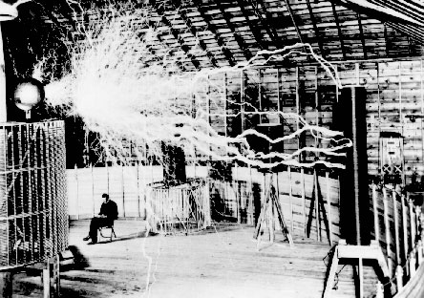
Nikola Tesla
The Colorado Springs lab possessed the largest Tesla Coil ever built, known as the "Magnifying Transmitter".
Tesla managed to transmit tens of thousands of watts of power without wires using the magnifier.
  Tesla posted a large fence around the coil with a sign, "Keep Out - Great Danger".
Tesla's Magnifying Transmitter, at fifty-two feet in diameter, generated millions of volts of electricity and produced lightning bolts more than one-hundred feet long (30.5 metres).
The Magnifying Transmitter produced thunder which was heard as far away as Cripple Creek. He became the first man to create electrical effects on the scale of lightning.
  People near the lab would observe sparks
  emitting from the ground to their feet and
  through their shoes.
  The area around the laboratory would glow
  with a blue corona (similar to St. Elmo's Fire).
CS 245 – Robotics and Machine Learning

Slide 22
Nikola Tesla
In the Colorado Springs lab
  Tesla recorded what he concluded were extraterrestrial radio signals and announced his findings in some of the scientific journals of the time.
    His announcements and data were rejected by the scientific community who did not believe him.
  He notes measurements of repetitive signals from his receiver which are substantially different from the signals he had noted from storms and earth noise. Specifically, he later recalled that the signals appeared in groups of clicks 1, 2, 3, and 4 clicks together.
  Later on, scientists determined that he probably received radio signals originating from Jupiter
  Tesla left Colorado Springs on January 7, 1900.
    The lab was torn down, broken up, and its contents sold to pay debts.
CS 245 – Robotics and Machine Learning

Slide 23
Nikola Tesla
In 1900
  Tesla began planning the Wardenclyffe Tower facility
In 1901
  the construction began on land near Long Island Sound. Tesla's project was funded by influential industrialists and other venture capitalists.
In June 1902
  Tesla's lab operations were moved to Wardenclyffe from Houston Street
In 1903
  the tower structure neared completion, although it was not yet functional due to a design error. In Electrical World and Engineer (March 5, 1904), Tesla reportedly determined the mode of ball lightning formation and produced them artificially.
  The tower was meant to be the start of a global system for wireless telecommunications and a national (and later global) system of towers broadcasting power to users as radio waves.
  Though never completed successfully in Tesla's lifetime due to lack of funding, and finally dismantled for scrap during wartime, its principles are currently being implemented by a U.S. military project in Alaska, spanning several hundred acres.
    However, Project HAARP, as it is called, targets a different objective. While Tesla's tower was to be his supreme test of the applicability of transmitted power, HAARP is being used to study ionospheric effects on radio communication.
CS 245 – Robotics and Machine Learning

Slide 24
Nikola Tesla
When he was eighty-one
  Tesla challenged Albert Einstein's theory of relativity, announcing he was working on a dynamic theory of gravity and argued that a field of force was a better concept and did away with the curvature of space.
  Unfortunately the theory was never published, but Tesla may have been developing a theory about gravity waves.
  This theory provides a basis for plasma cosmology. Click here for more on that.
Tesla died alone in the hotel New Yorker of heart failure, some time between the evening of January 5 and the morning of January 8, 1943.
  Despite selling his AC electricity patents, he was essentially destitute and died with significant debts.
At the time of his death:
  Tesla had been working on some form of teleforce weapon, or death ray, the secrets of which he had offered to the United States War Department on the morning of January 5.
  It appears that his proposed death ray was related to his research into ball lightning and plasma. He was found dead 3 days later and, after the FBI was contacted by the War Department, his papers were declared to be top secret.
  Immediately after Tesla's death became known, the Federal Bureau of Investigation instructed the Office of Alien Property to take possession of his papers and property, despite his US citizenship. All of his personal effects were seized on the advice of presidential advisors. J. Edgar Hoover declared the case "most secret," because of the nature of Tesla's inventions and patents.
  In 1976, a bronze statue of Tesla was placed at Niagara Falls.
CS 245 – Robotics and Machine Learning

Slide 25
Nikola Tesla
So how did Tesla influence Robotics?
  “Soon I became aware, to my surprise, that every thought I conceived was suggested by an external impression. Not only this but all my actions were prompted in a similar way. In the course of time it became perfectly evident to me that I was merely an automation endowed with power OF MOVEMENT RESPONDING TO THE STIMULI OF THE SENSE ORGANS AND THINKING AND ACTING ACCORDINGLY. The practical result of this was the art of teleautomatics which has been so far carried out only in an imperfect manner. Its latent possibilities will, however be eventually shown. I have been years planning self-controlled automata and believe that mechanisms can be produced which will act as if possessed of reason, to a limited degree, and will create a revolution in many commercial and industrial departments.”
CS 245 – Robotics and Machine Learning

Slide 26
Nikola Tesla
Nikola Tesla developed one of the first examples of remote control.
In 1898 Tesla announced his invention of a teleautomatic boat guided by remote control.
  When skepticism was voiced, Tesla proved his claims for it before a crowd in Madison Square Garden.
  In this patent, there is the first solutions for controlling from a given point the operation of machines.
“Our bodies are of similar construction and exposed to the same external forces. This results in likeness of response and concordance of the general activities on which all our social and other rules and laws are based. We are automata entirely controlled by the forces of the medium, being tossed about like corks on the surface of the water, but mistaking the resultant of the impulses from the outside for the free will. The movements and other actions we perform are always life preservative and though seemingly quite independent from one another, we are connected by invisible links. “
“…I am inviting other students of nature to devote attention to this subject, believing that through combined systematic effort, results of incalculable value to the world will be attained. The idea of constructing an automaton, to bear out my theory, presented itself to me early, but I did not begin active work until 1895, when I started my wireless investigations. During the succeeding two or three years, a number of automatic mechanisms, to be actuated from a distance, were constructed by me and exhibited to visitors in my laboratory. “
CS 245 – Robotics and Machine Learning

Slide 27
Nikola Tesla
“Telautomats will be ultimately produced, capable of acting as if possessed of their own intelligence, and their advent will create a revolution.”
“It is particularly regrettable that a punitive policy was adopted in framing the terms of peace, because a few years hence, it will be possible for nations to fight without armies, ships or guns, by weapons far more terrible, to the destructive action and range of which there is virtually no limit. Any city, at a distance, whatsoever, from the enemy, can be destroyed by him and no power on earth can stop him from doing so. If we want to avert an impending calamity and a state of things which may transform the globe into an inferno, we should push the development of flying machines and wireless transmission of energy without an instant’s delay and with all the power and resources of the nation.”
CS 245 – Robotics and Machine Learning

Slide 28
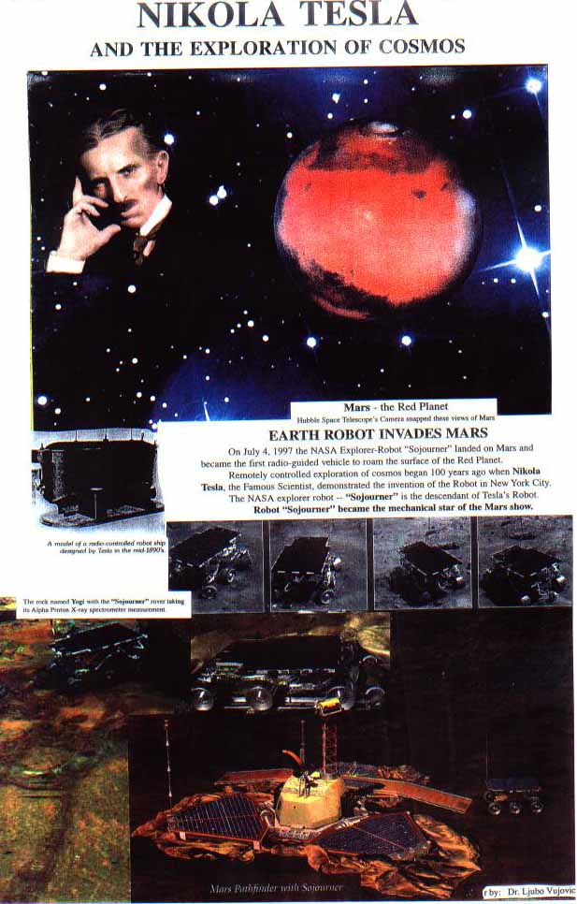
Nikola Tesla
On July 4, 1997
  The NASA Explorer-Robot "Sojourner" landed on Mars and became the first radio-guided vehicle to roam the surface of the Red Planet.
  Remotely controlled exploration of cosmos began 100 years ago when Nikola Tesla discovered radio wave transmission.
CS 245 – Robotics and Machine Learning

Slide 29
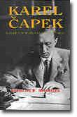
Term “ROBOT”
Karel Capek
  The use of the word Robot was introduced into his play
  R.U.R. (Rossum's Universal Robots) which opened in Prague
  in January 1921.
    In R.U.R., Capek poses a paradise, where the machines initially bring so many benefits but in the end bring an equal amount of blight in the form of unemployment and social unrest.
  Robots were not mechanical in nature
    They were created through chemical means
  "It is with horror, frankly, that he rejects all responsibility for the idea that metal contraptions could ever replace human beings, and that by means of wires they could awaken something like life, love, or rebellion. He would deem this dark prospect to be either an overestimation of machines, or a grave offence against life."
  [The Author of Robots Defends Himself - Karl Capek, Lidove noviny, June 9, 1935]
CS 245 – Robotics and Machine Learning

Slide 30
Industrial Robotics
George C. Devol and Joseph F. Engelberger
Engelberger started a manufacturing company 'Unimation' (universal automation)
  the first commercial company to make robots
  Their first robot nicknamed the 'Unimate'.
  The first Unimate was installed at a General Motors plant to work with heated die-casting machines.
    Most Unimates were sold to extract die castings from die casting machines and to perform spot welding on auto bodies, both tasks being particularly hateful jobs for people.
  Ultimately Westinghouse acquired Unimation and the entrepreneurs' dream of wealth was achieved.
  Unimation is still in production today, with robots for sale.
CS 245 – Robotics and Machine Learning

Slide 31
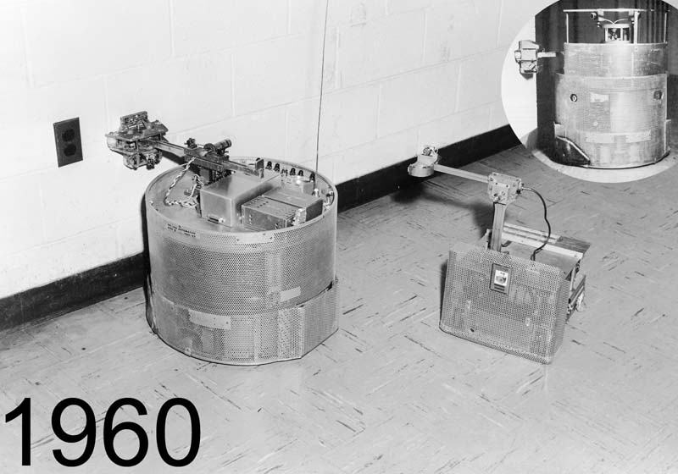
Hopkins Beast
(1961-63) Using dozens of transistors, the Johns Hopkins University Applied Physics Lab's "Beast" wandered white hallways
  Centering by sonar, until its batteries ran low
  Then it would seek black wall outlets with special photocell optics, and plug itself in by feel with its special recharging arm.
  After feeding, it would resume patrolling.
CS 245 – Robotics and Machine Learning

Slide 32
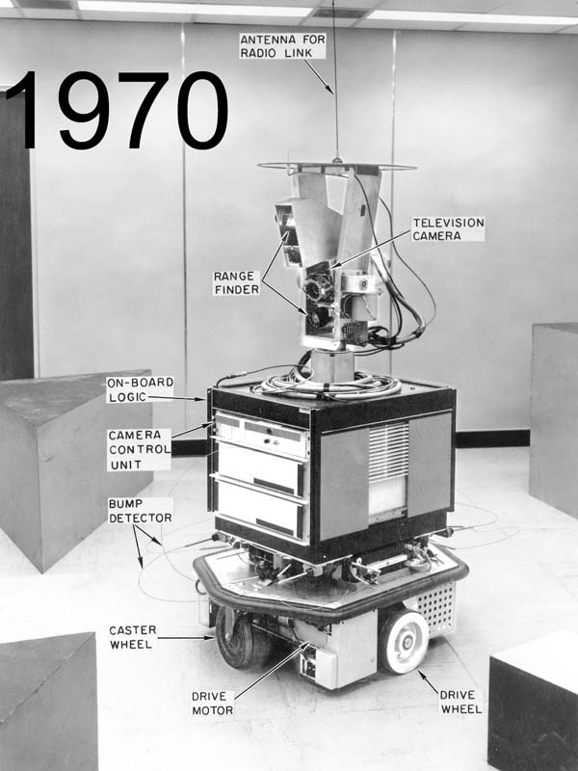
Stanford Shakey and Cart
"Stanford Cart" line follower and SRI's "Shakey" were the first mobile robots to be controlled by computers
  Computers ⬄ large mainframes doing about a quarter million calculations per second, linked to the vehicles by radio)
  Both used television cameras to see.
Shakey
  Lived in “Blocksworld”
CS 245 – Robotics and Machine Learning

Slide 33
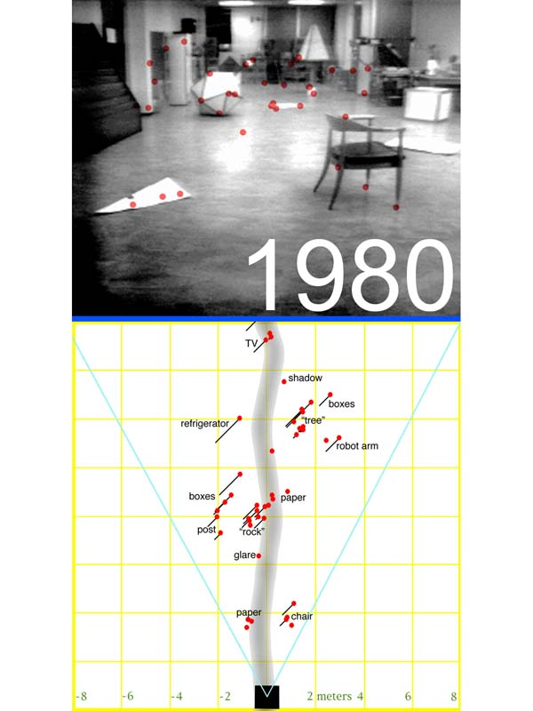
Stanford Cart 3D obstacle mapper
1980
A million calculation per second computer and more complex program allowed the Cart to sparsely map and negotiate obstacle courses, taking five hours to cover 30 meters, a sluglike performance.
CS 245 – Robotics and Machine Learning

Slide 34
Robots of Today/Tomorrow
Honda Asimo - Androids
Sony Aibo - Toy
Roomba – Robot Vacuum
DaVinci – Surgery (telerobot!)
Military Robots
What kind of Robots will we see in the future?
CS 245 – Robotics and Machine Learning

